Slide 1

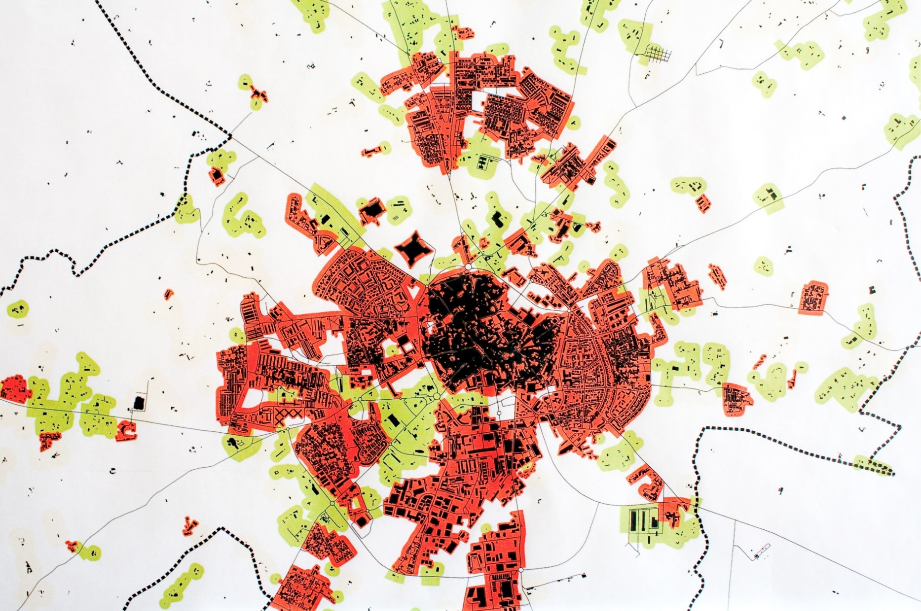


Cor azul para títulos:
RGB(26,67,155)
Tipos (de letra):
Títulos e destaques → Roboto Medium
Corpo do texto → Roboto Light
(evitar o uso de bold; usar Roboto Medium em alternativa)
Título numa linha (preferível) ou duas (se necessário).
Monitorização contínua de disparos de armas de fogo numa cidade
Cristina Silva, Joana Maria, Quinato Rafael, Joana Maria, Quinino Rafael, Quinino Rafael Almeida
Orientador: Prof. José Quinino
Última linha:
designação da unidade curricular, ou
grau, para as dissertações/teses, e.g.: Mestrado em Engenharia Informática
Projeto em Engenharia Informática, 3º ano, MIECT.
2017
Área para o logo do projeto/trabalho, se aplicável. Deve ficar delimitado pelo quadrado indicado pelas guias.
(activar a visualização das guias)
Resumo
In 1828, the English mathematician George Green (1793-1841), who up to his forties was working as a baker and a miller, published an essay where he introduced a formula connecting the line integral around a simple closed curve with a double integral. Within years, this result turned out to be useful in many fields of mathematics, physics and engineering. Generalizations of Green’s theorem have chosen different directions, and are known as the Kelvin-Stokes and the Gauss-Ostrogradsky theorems.
Língua sugerida:
Português ou inglês.
Fig 3- Other caption here.
The following is just placeholder filling text. The following is just placeholder filling text. The following is just placeholder filling text.
different forms of fractional derivative operators were introduced, e.g., Hadamard, Riemann–Liouville, Caputo, Riesz, Cresson, Katugampola, Klimek, and many results of classical analysis were extended to the noninteger case.
different forms of fractional derivative operators were introduced, e.g., Hadamard, Riemann–Liouville, Caputo, Riesz, Cresson, Katugampola, Klimek, and many results of classical analysis were extended to the noninteger case. different forms of fractional derivative operators were introduced, e.g., Hadamard, Riemann–Liouville, Caputo, Riesz, Cresson, Katugampola, Klimek, and many results of classical analysis were extended to the noninteger case.
This work received The Grunvald-Letnikov award for the best student paper – theory, on the Inter-national Conference “Fractional Differentiation and Applications”, that took place in Nanjing, China, from 14th to 17th May 2012 (see Fig. 1).
Conclusion
This work received The Grunvald-Letnikov award for the best student paper – theory, on the Inter-national Conference “Fractional Differentiation and Applications”, that took place in Nanjing, China, from 14th to 17th May 2012 (see Fig. 1).
References
Pinho, C., Madaleno, M. and Santos, H. (2013), “The usefulness of financial analysts reports: A content analysis approach”, International Journal of Management (IJM), June, Vol. 30, No. 2, Part 2, pp. 631-648; ISSN: 0813-0183.
Coluna vertical (à esquerda) deve ficar vazia
Fig 1- Caption goes here.
Produção do PDF da versão final:
atenção à qualidade das imagens originais: pelo menos 300dpi (cores) ou 600dpi (escala de cinzentos).
o Office 2016 permite exportar PDF (File>Export>Create PDF). Selecionar: Optimize for Printing
Conferir que o PDF produzido tem a qualidade pretendida: fazer zoom a 400% e confirmar o aspeto dos elementos do poster.
Fig 2- Caption goes here.
Methods
On that day, L’Hopital wrote a letter to Leibniz, where he asked about Leibniz’s notation of nth order derivatives. L’Hopital wanted to know the result for the derivative of order n = 1/2. Leibniz replied that “one day, useful consequences will be drawn” and, in fact, his vision became a reality. Katugampola, Klimek, and many results of classical analysis were analysis were analysis were Katugampola, Klimek, and many results of classical analysis were analysis were analysis were
Katugampola, Klimek, and many results of classical analysis were analysis were analysis were
Procurar que o corpo fique alinhado pela guia, nas duas colunas.
COLOCAR LOGOTIPOS DAS INSTITUIÇÕES FINANCIADORAS

